Slide 1

HomeCo Strategic Plan
17 February 2023
Felipe Garavano
Congjie An
Jackson Burke
Kenza Baddou
Aline Helburg
Sanjana Gupta

Slide 2
Table of Contents
Executive Summary
Background
Analysis & recommendations
Dashboard, KPIs, & Next Steps

Slide 3
Executive Summary
HomeCo possesses a large database of order and product information and has immense opportunity use this data to better inform its strategy
Our team dug into the existing data and identified potential growth strategies focused on…
Key Customers
Key Categories
Key Products
Accordingly, each strategies’ success can be tracked by Executive Team in a custom KPI dashboard
Moving forward, HomeCo can continue to utilize its data for regular performance monitoring and strategy adaptation

Slide 4
Background

Slide 5
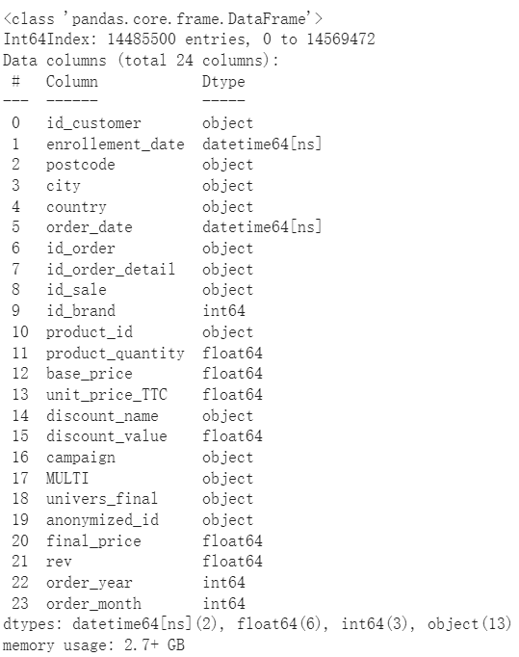
Our team focused primarily on the Order History files, given the richness of information in the data
What we observed
It's a large dataset so we tried to use the full historical data or a shorter period depending on the business question
Interesting customer data at transaction level which allows for interesting analysis in many different aspects and potential for AI and ML algorithms
What we did
Pre-processed the data: fixing punctuation, creating new variables
Computed of business statistics like revenue across years per month to compare with external market trends
Built a dataframe with the RFM values per customer to use for a CLV model and segmentation to predict their value in the next 6 months
Calculated the share spent by each customer in each individual category and the shelf life of all products

Slide 6
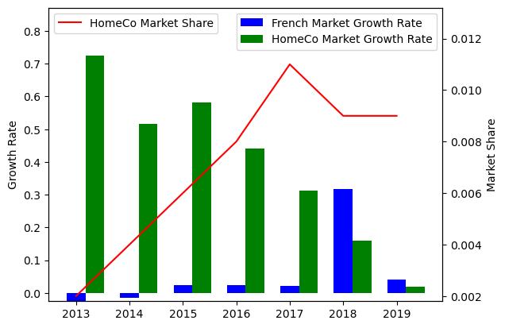
HomeCo grew quickly in the early to mid 2010s, but its growth has since leveled off
HomeCo vs. French Furniture Market Performance (2013-2019)
Key Takeaways
HomeCo growth ran counter to overall market stagnation from 2013-2017
However, since 2018, HomeCo has struggled in comparison to the broader market
Overall market share peaked in 2017 at ~1.2% but has now dropped below 1%
HomeCo requires a renewed growth strategy to return to it’s previous record of success

Slide 7
Analysis & Recommendations

Slide 8



3 strategic recommendations aim to increase revenue, putting HomeCo back on track to double-digit growth
Target Key Customers
Analysis shows extreme variance in customer behavior and value
Recommendation: Market more heavily towards valuable segments and deprioritize others
Focus on Key Categories
Popularity and value amongst furniture categories varies greatly
Recommendation: Prioritize orders from categories with highest forecasted value (based on CLV analysis)
Improve Product Strategy
Certain products are ordered quickly while others sit on the shelf
Recommendation: Optimize product pricing and quantity ordered to minimize shelf life and increase revenue

Slide 9
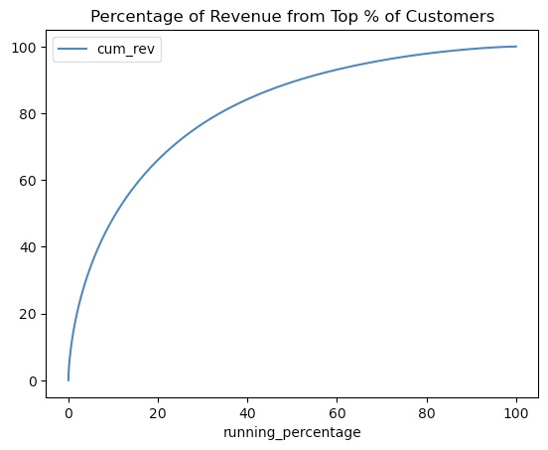
Observing customer behavior, it becomes clear that certain segments are far more valuable than others
Key Takeaways:
20% of the customers who purchased the most generate nearly 75% of the total revenue, which fits the Pareto Principle
Customers who purchased more than one time count for over 84% of the total revenue
As such, we need to focus on top customers who make repeat purchases

Slide 10



We computed a Customer Lifetime Value analysis based on recency, frequency, and monetary value
We made a RFM analysis for all customers with at least 2 orders.
Recency
Frequency
MONETARY
Age in Months at time of last order
Number of lifetime orders
Average amount spend per order
Average
Average
Average
24
4
70

Slide 11
Based on RFM analysis, we computed CLV for customers with <-- 1 purchase and divided them into 4 segments
One-hit wonders
Lost
Loyal Base
Golden eggs
Customers who have made only 1 purchase in their lifetime.
These are about half our historic customers.
Old customers who have probably left us since they have low frequency and recency. Altough they are a significant amount, they don't account for a large share of revenue
Top 35%.
They are relatively old customers, have a good frequency, and recency, their monetary value is not great, but they are loyal and account for 30% of total revenue.
Top 10%
They account for 50% of the total revenue generated!
They have high frequency, recency, monetary value and are on average newer.
of customers
80%
of Total Revenue
35%

Slide 12
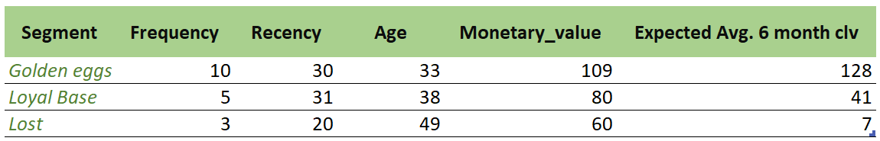
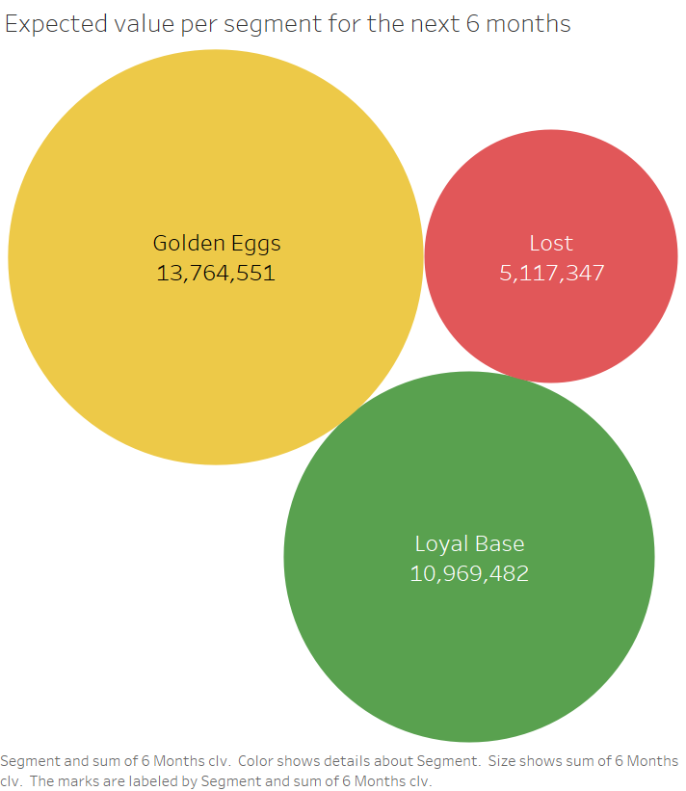
Each segment has distinct characteristics, illustrating their differential value to HomeCo
Here we have the characteristics of the average customer per segment. Frequency refers to the number of purchases done in their lifetime, recency is the age of the customer in months at the time of last order, monetary value refers to the average amount spent per order and the expected CLV is the value they will bring on average in the next 6 months.
Golden eggs are the most frequent, very recent and have the highest monetary value.​
The lost segment are the oldest by quite a lot and have low frequency and recency indicating they are probably lost.
The Golden Eggs represent the largest expected value in the next 6 months even though they are only 10% of our customer base. Our loyal base also represents a large part of the value, it could be interesting to target these two segments.

Slide 13
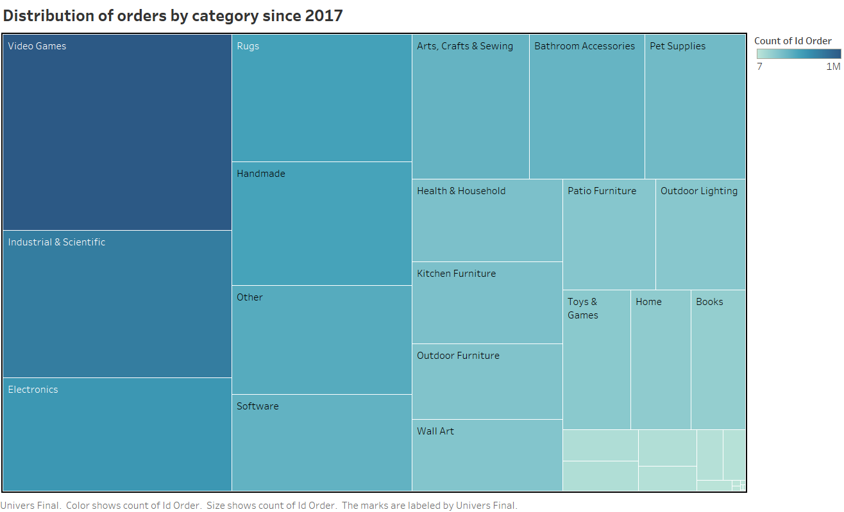
We then analyzed our revenue breakdown by category, and observed strong variance in category importance
We can see most orders since 2017 have been placed on Video Games, Industrial and Scientific, and Electronics.

Slide 14
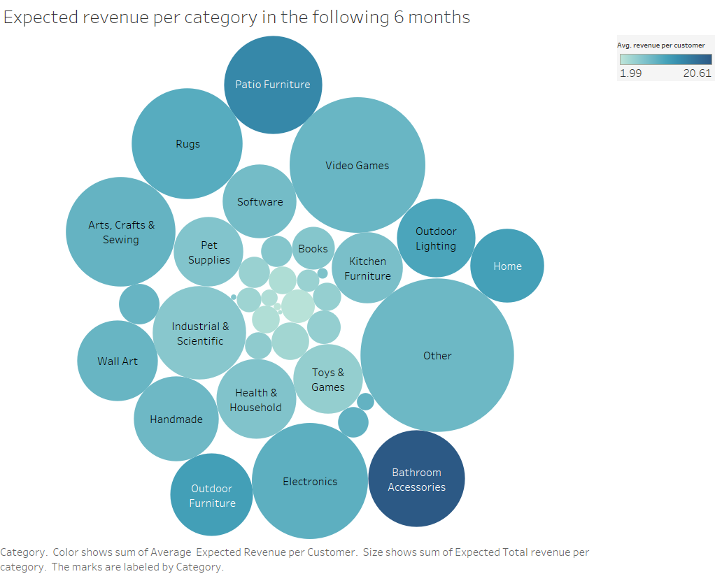
Pairing the CLV analysis with category history allowed us to project the most crucial categories going forward
We computed the CLV for all customers with at least 1 purchase and divided them into 3 segments
Some categories like Bathroom Accessories have very high average revenue per customer though a smaller total expected revenue indicating few customers but potential growth
Video games is the category with the most orders, yet the average is not so high.
Rugs have high average and high total expected revenue, so it could be a good category to focus on.

Slide 15
Product-level analysis can help HomeCo order more attractive products at appropriate quantities
Individual product “success” can be measured by three factors
Number of products sold
Time it takes clear products from the shelf
Percentage discount applied from the suggested “PVC” price
Optimization along these dimensions can increase profitability for HomeCo
Additional note: Though data not available, also crucial for HomeCo to measure product-level profitability with cost data

Slide 16
Dashboard, KPIs, & Next Steps

Slide 17
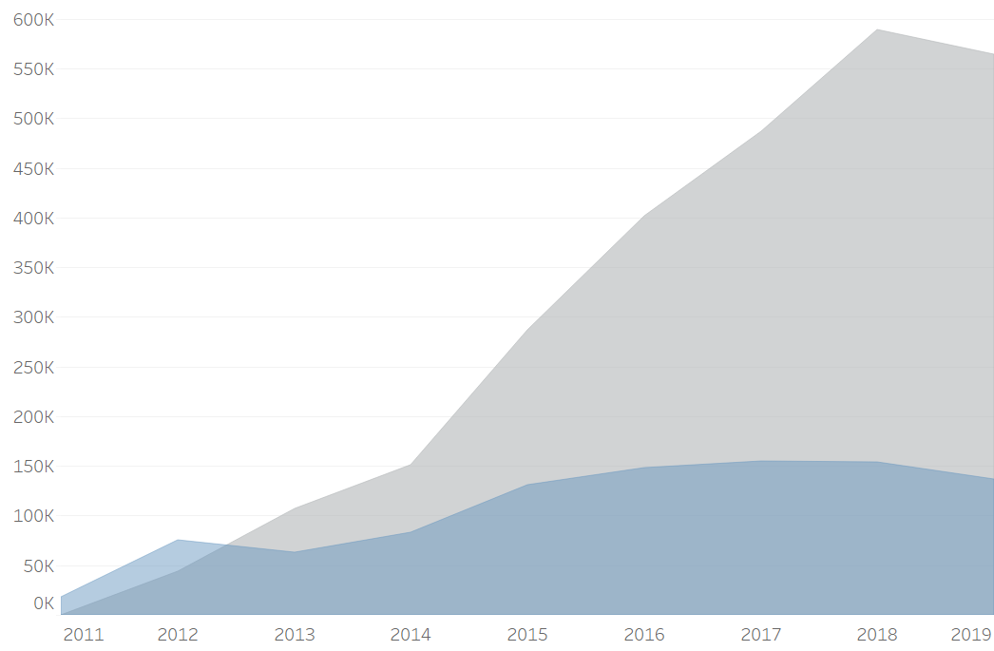
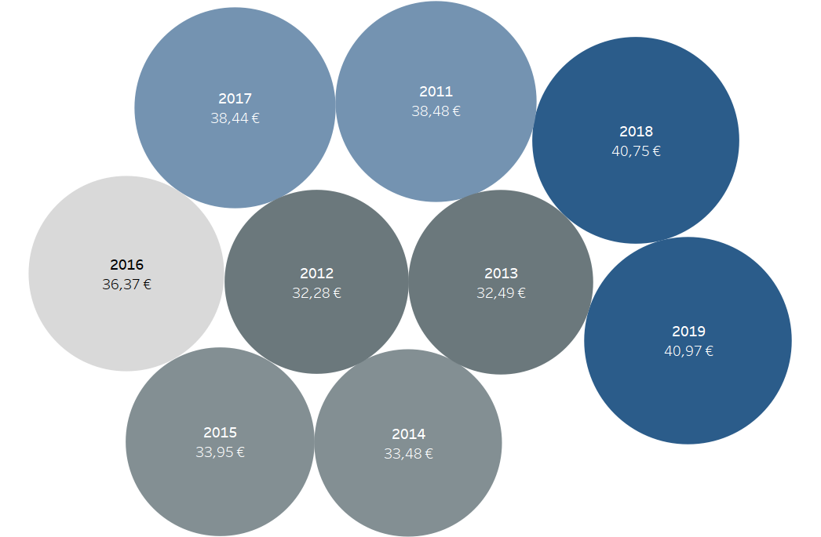
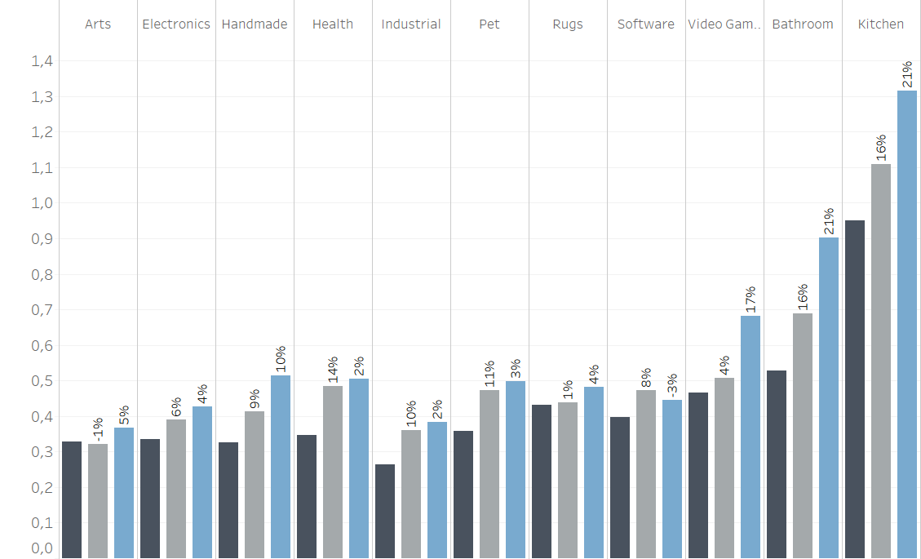
Strategic Recommendations & KPIs
Strategic Recommendations | KPI & Explanation | KPI Tracking Dashboard
Target Key Customers | Customer Retention & Customer Growth. As we target customer segments more effectively, we expect our existing customer base to grow Additionally tracking new customer growth is an important metric to measure if our business is reaching out affectively to new customer groups
Focus on Key Categories | Average Order Value. Given that our key categories are those which will provide us the most average revenue per order, tracking this metric will give us an idea of if we are pushing and ordering from the correct categories
Improve Product Strategy | Average Product Shelf Life. Tracking this metric illustrates which products are taking longer to sell and probably need to be repriced It also shows which products sell off quickly and need more stocks as they are in demand.

Slide 18
Conclusion & Next Steps
Conclusion
Given HomeCo’s slowing growth, it’s imperative that the company revisit its strategy and take a data-driven approach to sales & marketing, including addressing the following…
Bringing in new customers through the growth of specific categories with high potential value like rugs
Better pricing strategy for products based on their shelf life
Nurturing customers that are the most valuable and loyal based on a dynamic segmentation
Next Steps
Refinement and implementation of three strategic recommendations around customer, category, and product
Monitoring of KPI dashboard by Executive Team to ensure adherence to recommendations
Continued investigation into product and consumer trends using data and our disposal

Slide 19
Appendix

Slide 20
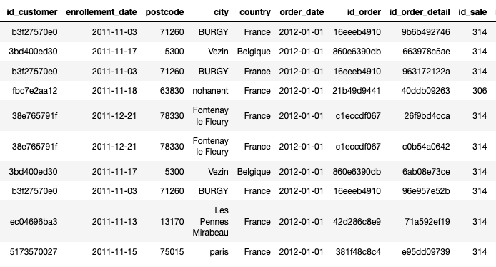
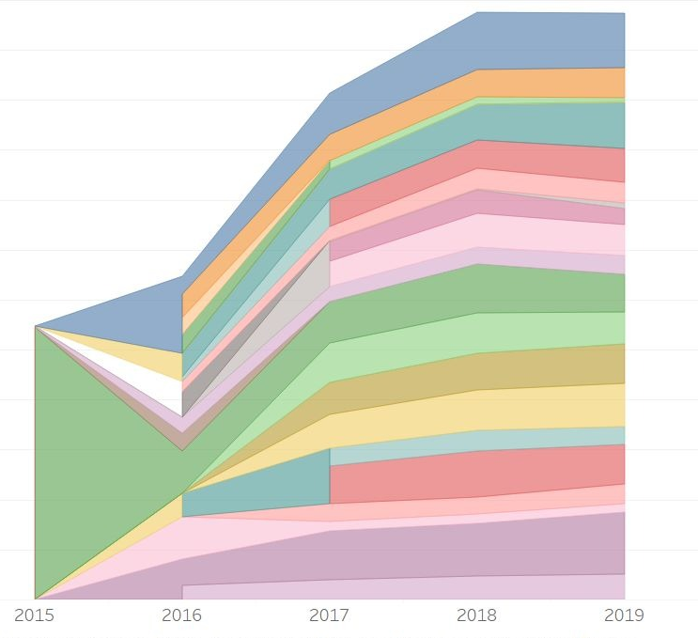
As HomeCo orients itself to become more data-driven, it should aim to keep the dataset as clean and consistent as possible
From 2011 to 2019, HomeCo changed its data collection methods, making it more challenging to run analyses over time
2013: ‘id_sale’ column becomes a unique alphanumeric key identifying each individual sale vs. a specific brand or product:
Before: 10541
After: c70daf2479
2018: ‘id_sale’ column returns to the previous state of being short 4-5 length integers, identifying products or brands instead of sales.
2011 | 2012 | 2013 | 2014 | 2015 | 2016 | 2017 | 2018 | 2019
2011: Operations and/or sales data collection begins with 45,106 orders tracked
2015-2017: Number of Categories increasing, and the ‘Other’ category becomes much less significant

